Slide 1

Wearable Electronics for Sports
VERSUS
Sona College of Technology

Slide 2
VERSUS
Surya Narayanan CS
B.E – 3rd semester
ECE Department
I am ready to apply my knowledge into practical
Has won the Smart-O-Thon (Hackathon) conducted by Code Chef(2021).
Has won the Kode-!O-Thon(Hackathon) conducted by Anna University (2022).
Participated In the Hack-A-Web contest and shortlisted in the top 100 teams.
Sakthi C
B.E – 3rd semester
ECE Department
I'm interested in IoT and embedded systems .Also presented 15 papers In paper presentation regarding embedded systems.
Notes:
Mention the details of the participants

Slide 3
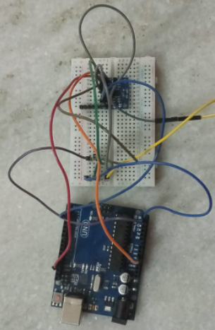
Challenge 1 - Smart wearable to track and record the players
Components Used:
GPS
Accelerometer sensor
Inertial Sensor
Players real time temp, accX, accY, accZ, and three axis gyro and angles will be measured and plotted, so that will get the match analysis of the player.

Slide 4
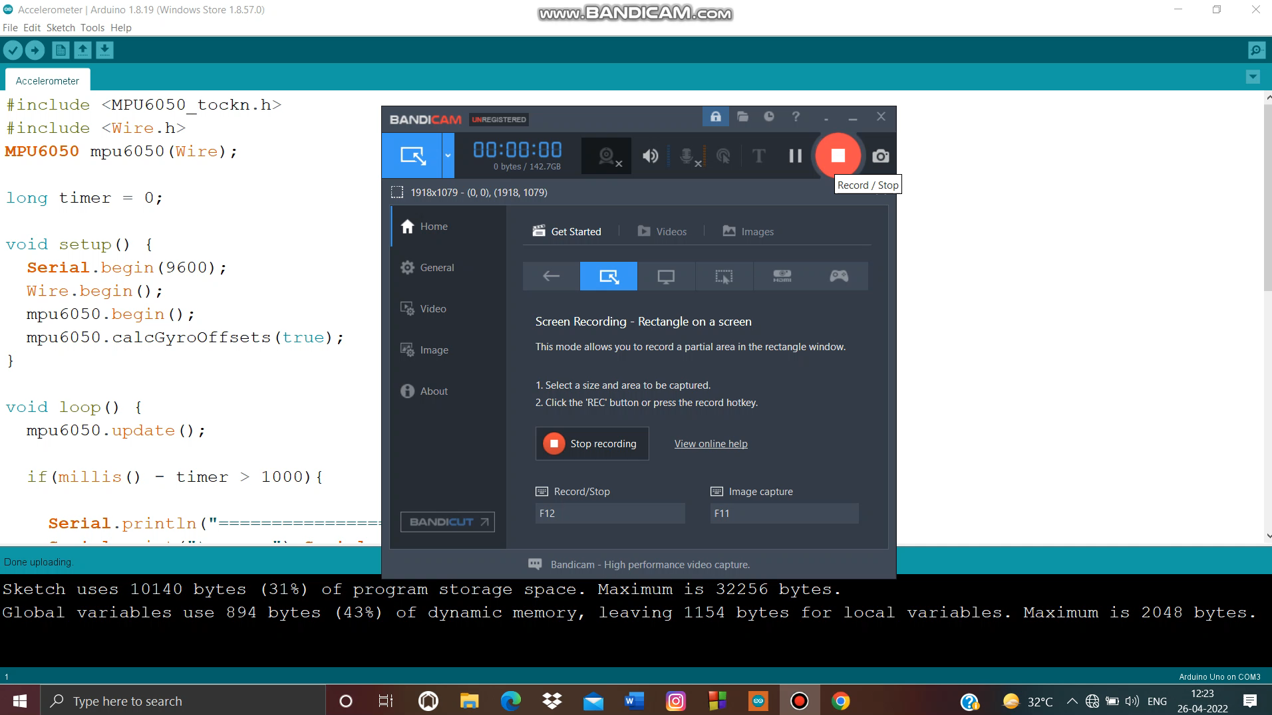
Challenge 1 – Prototype Demo

Slide 5
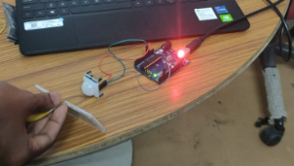
Challenge -2 –Detect D-Box foul
Components Used:
PIR sensor
LED
Major fouls in hockey is a D-Box foul. So we developed a prototype detecting D-Box fouls using PIR sensor. D-Box foul is a foul in which a player attains a foul if he scored a goal out of the D-Box. We have used a simple algorithm in which if the player crosses the PIR sensor, he will be given a foul.

Slide 6
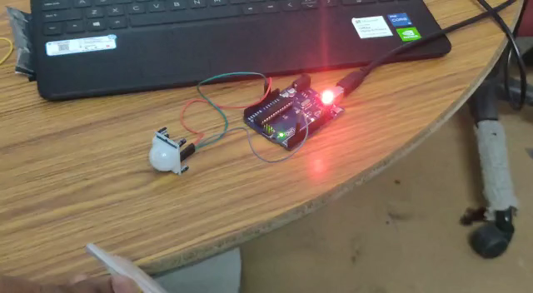
Challenge -2 –Detect D-Box foul

Slide 7
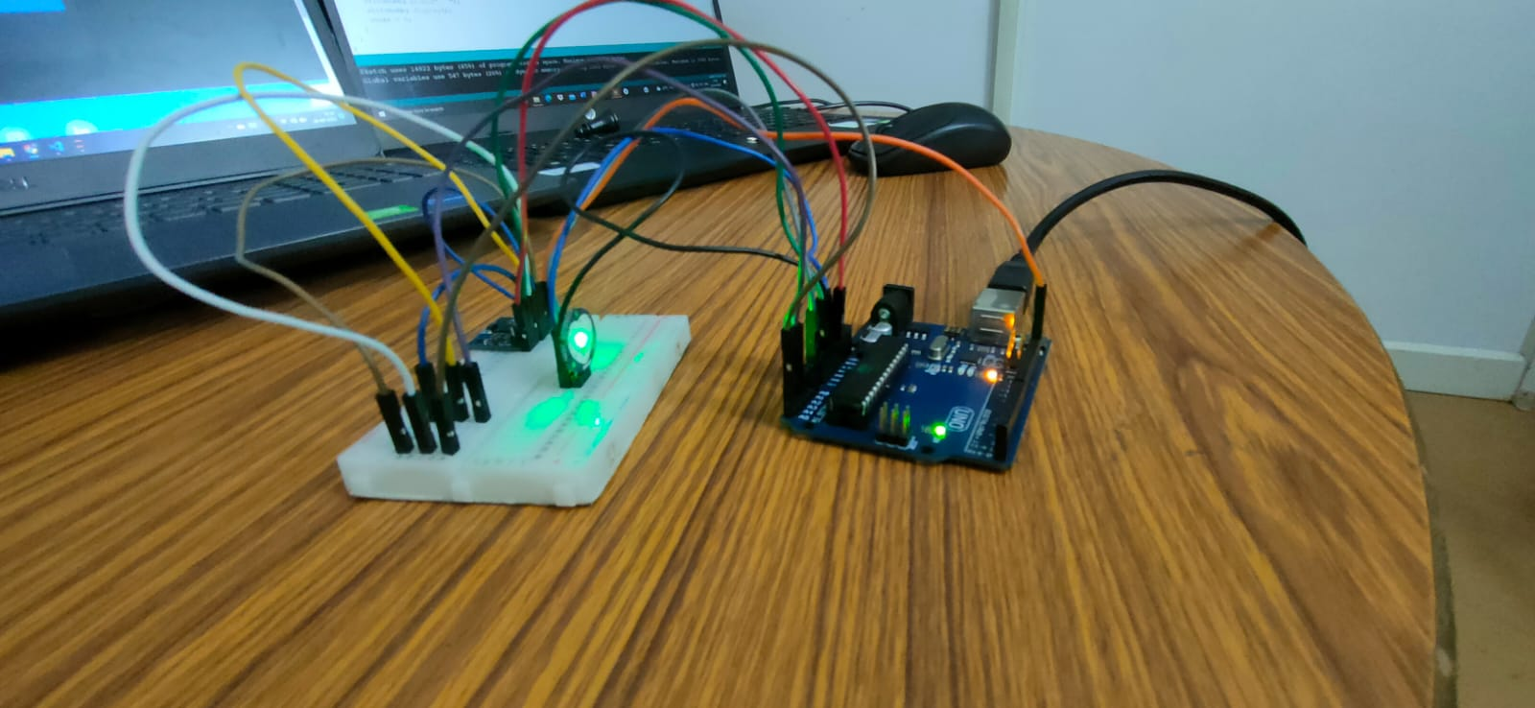
Challenge -3 - Find the player’s health (tiredness) and inform the coach
Components Used:
Heart Pulse sensor
Pedometer
Software Used:
IFTTT
Applets Used:
Web Hooks
Android SMS
No of Steps the player runs during the match is being measured by pedometer. Heart rate is measured by BPM sensor. Based on these two parameters tiredness of the person will be monitored and the coach get notified when if any abnormalities monitored in player’s health.

Slide 8
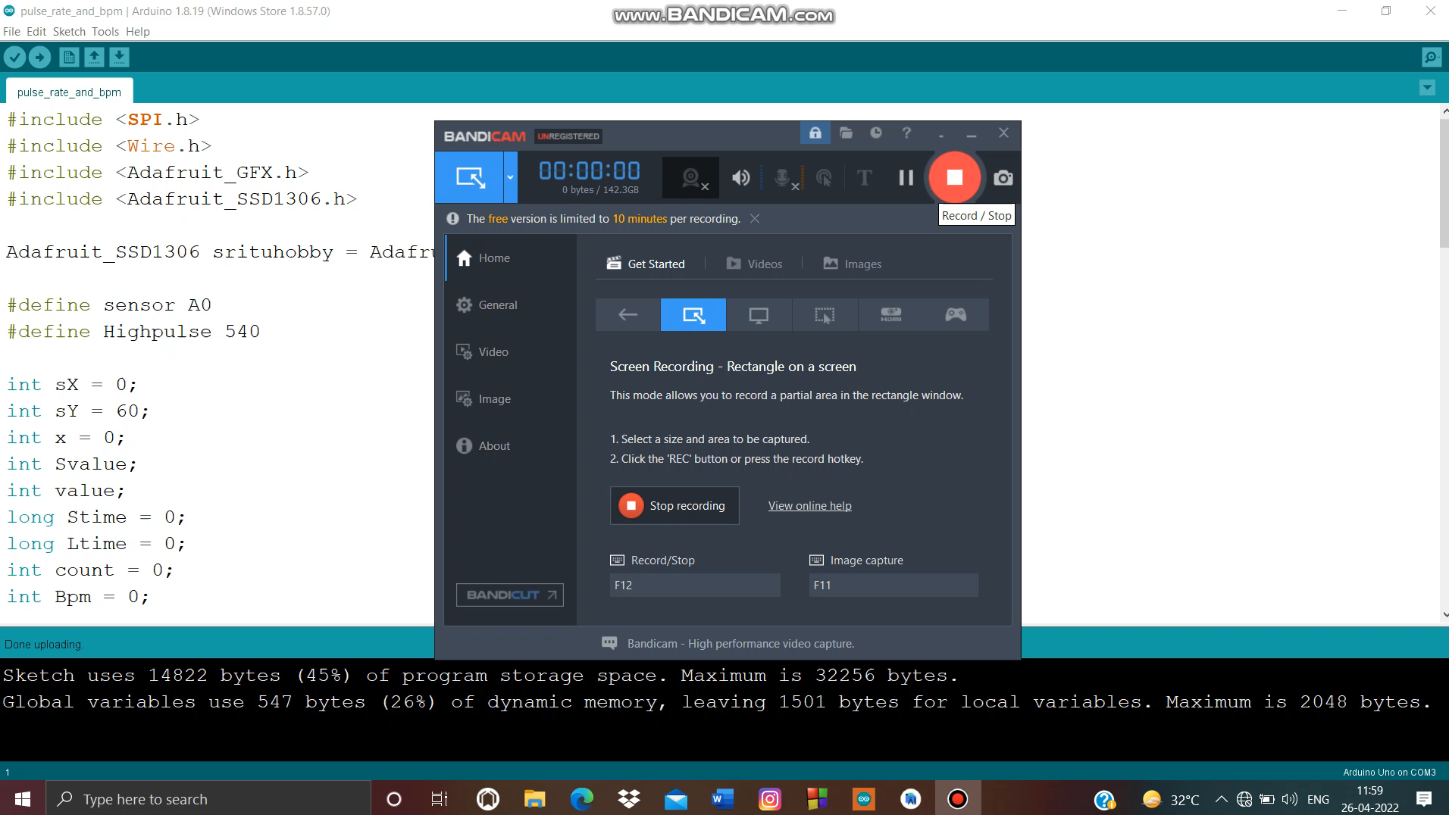
Challenge -3 - Find the player’s health (tiredness) and inform the coach

Slide 9
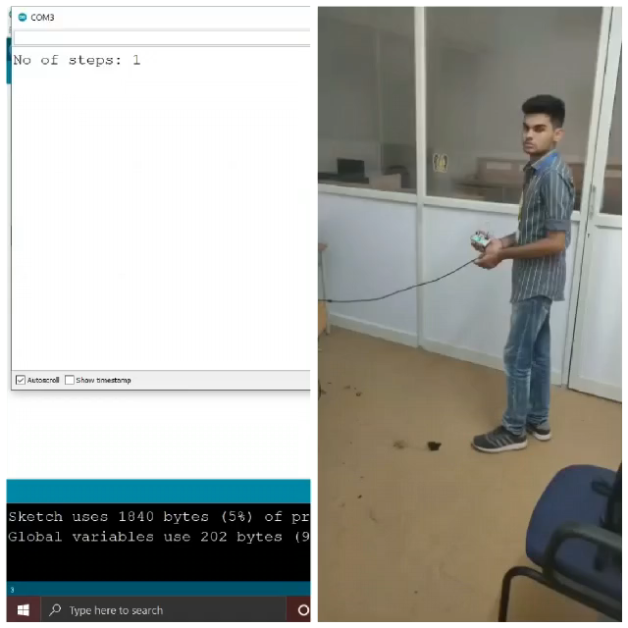
Challenge -3 - Find the player’s health (tiredness) and inform the coach

Slide 10
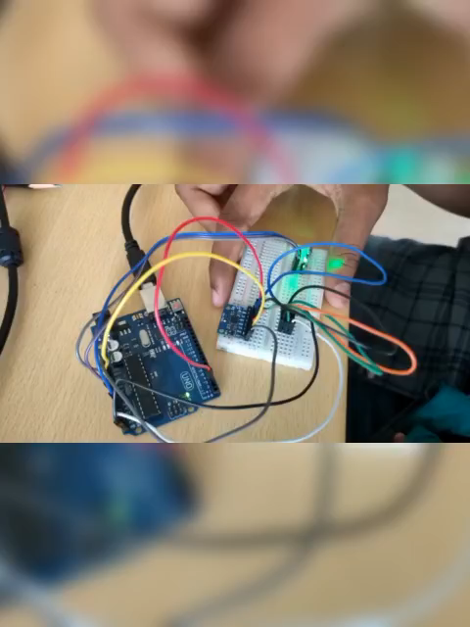
Challenge -3 - Find the player’s health (tiredness) and inform the coach

Slide 11
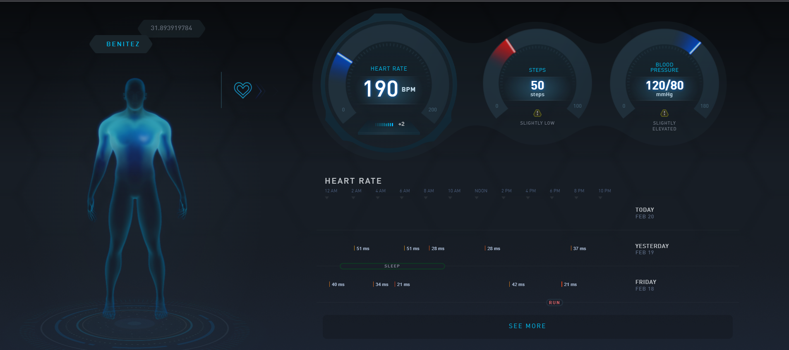
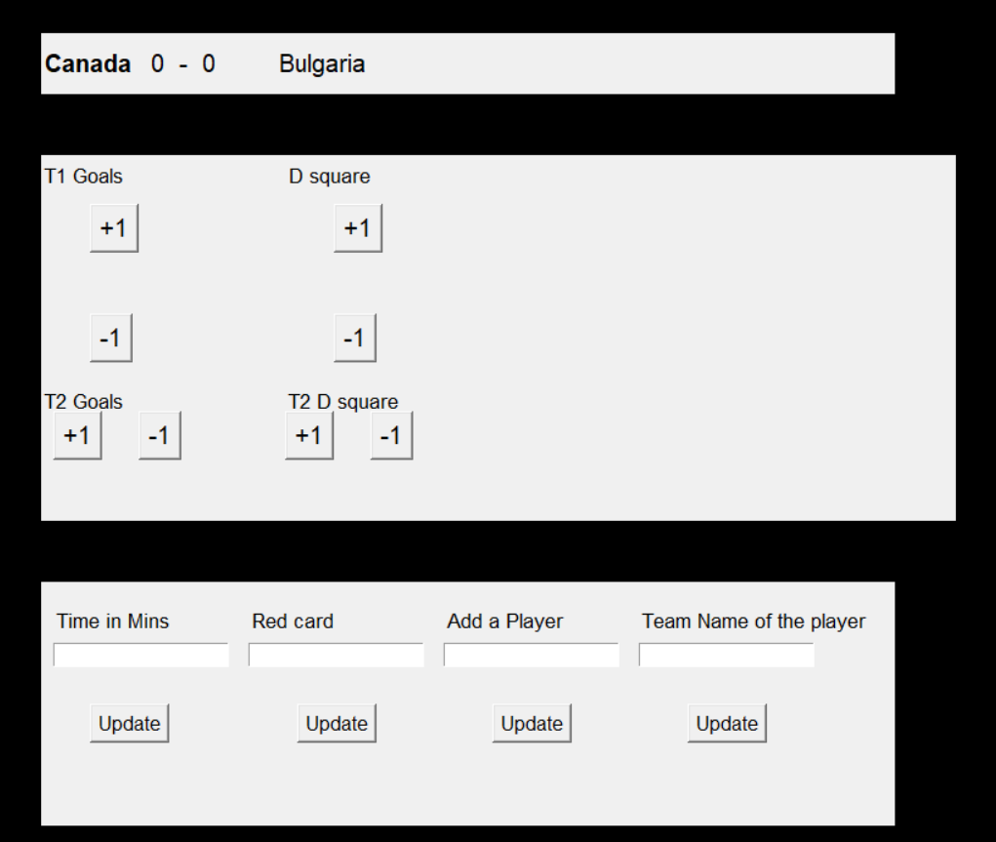
Challenge 4- Hockey dashboard - Cloud/Web-based software
HTML & CSS
JS
PHP
Tomcat
Python
SQL
Frontend and Backend Languages

Slide 12
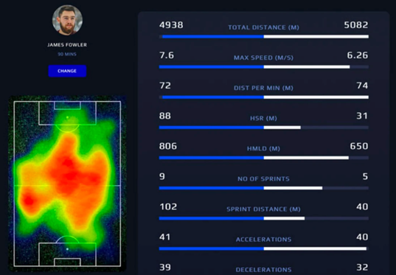
Plotting the Co-ordinates of the player
Taking the coordinates from the mpu and the no of sprints and the heart rate per minute from the sensors, plotting the co-ordinates and analyzing the parameters like Heart rate, our web application will give the following output.

